Slide 1
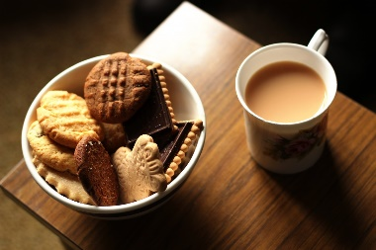
Research and Writing Coach-in
Get individual help from librarians and writing tutors on research, writing and citation for all subjects.
Where: Writing and Tutoring Centre (1st floor of the Library)
When:
Jan. 22 Tues. 3-5 pm
Feb. 26 Tues. 3-5 pm
March 19 Tues. 3-5pm
Text "coach-in" to 604-670-6866 to get a reminder message with all the dates
Plenty of coffee and snacks will be available to keep you going!

